Slide 1
Company Presentation
Present by :

Slide 2
Content
01
About GoDEX
02
Services
03
Products
04
Contact
05
Q & A

Slide 3
About GoDEX
Company Profile
Missions / Objectives
Milestones
Financial Numbers
Awards / Certifications

Slide 4
Profile
Established in 1993, with its headquarters in Taipei Taiwan, GoDEX International is an engineering company that specializes in designing and manufacturing barcode printing products that lead the industry in the value price, high performance category. GoDEX has offices in the US, Europe and China and its products are distributed world-wide.
GoDEX has created its success and earned a loyal following of thousands of customers by providing very affordable products that are extremely well engineered and supported by a company and reseller Partner network that is 100% dedicated to long-term customer satisfaction.
About GoDEX
Notes:
科誠股份有限公司成立於 1993 年，專精於條碼印製機之研發與製造。科誠堅強的團隊累經多年的市場與產品開發的經驗，以及穩健的經營管理讓科誠(GoDEX)逐步成為台灣最頂尖的條碼印製機研發與製造者，並且擠身於世界前十大的實績。科誠產品已行銷全球超過70個國家，也多次榮獲台灣工業界大獎，如台灣精品獎、企業產品創新研究獎及最佳產品設計獎。

Slide 5
Missions
Committed to building a relationship of integrity, loyalty and mutual trust with customers.
Dedicated to the customers and try our best to meet their needs.
Create the most substantial and valuable barcode printers in the market.
About GoDEX
Notes:
致力於與客戶建立誠信、忠實、互信的關係。
全心全意為客戶著想，盡力於滿足客戶需求。
創造出業界最實惠，價值最高的條碼機產品。

Slide 6
Milestones
1993
Formation of GoDEX Taiwan
GoDEX products represented under the C.ITOH brand name in USA, Europe and Japan. GoDEX products are chosen to be implemented in a automated ticket booth system by Walt Disney (USA). 300 DPI printer's are added to the product range. Established GoDEX China office.
1995-1999
About GoDEX
GoDEX launches first industrial printer model EZ-4000 Series and achieves ISO 9001-2000 certification.
Introduced new desktop, Industrial product EZ-1000 / EZ-2000 series and PLUS series to the market
2000-2004
Notes:
科誠股份有限公司成立於 1993 年，專精於條碼印製機之研發與製造。科誠堅強的團隊累經多年的市場與產品開發的經驗，以及穩健的經營管理讓科誠(GoDEX)逐步成為台灣最頂尖的條碼印製機研發與製造者，並且擠身於世界前十大的實績。科誠產品已行銷全球超過70個國家，也多次榮獲台灣工業界大獎，如台灣精品獎、企業產品創新研究獎及最佳產品設計獎。

Slide 7
Milestones
Established GoDEX Europe and Americas subsidiary
2008-2009
On March 21st. 2012, GoDEX was listed on OTC in Taiwan GTSM stock market. (Trading Code: TW. 4987)
2012
About GoDEX
Introduced RT200i & RT700i series.
RT & ZX1000i & T20 & MX20/30 received the 2013, 2014 Taiwan Excellence Award
Achieved ISO 14001: 2004 Certification
2013-2014
Worldwide 1st 600 dpi desktop RT860i has been launched
Godex win the Award of TOP 5% Best Corporate Governance
2015
Notes:
科誠股份有限公司成立於 1993 年，專精於條碼印製機之研發與製造。科誠堅強的團隊累經多年的市場與產品開發的經驗，以及穩健的經營管理讓科誠(GoDEX)逐步成為台灣最頂尖的條碼印製機研發與製造者，並且擠身於世界前十大的實績。科誠產品已行銷全球超過70個國家，也多次榮獲台灣工業界大獎，如台灣精品獎、企業產品創新研究獎及最佳產品設計獎。

Slide 8
Milestones
GoDEX is ranked Top 5% of cooperate governance among TWSE/TPEx listed companies for the 2nd year
2016
GoDEX Ranked in the Top 5% of cooperate governance for TWSE/TPEx listed companies for the 3rd year . New Industrial ZX400/400i series has been introduced to the market. The best-in-class eight inch wide industrial barcode printer HD830i has been launched
About GoDEX
2017
GoAPP, GoRibbon has been launched to the market for various application purpose.
2018
Notes:
科誠股份有限公司成立於 1993 年，專精於條碼印製機之研發與製造。科誠堅強的團隊累經多年的市場與產品開發的經驗，以及穩健的經營管理讓科誠(GoDEX)逐步成為台灣最頂尖的條碼印製機研發與製造者，並且擠身於世界前十大的實績。科誠產品已行銷全球超過70個國家，也多次榮獲台灣工業界大獎，如台灣精品獎、企業產品創新研究獎及最佳產品設計獎。

Slide 9
Milestones
GoDEX Desktop printer GE300, Linerless printer DT4L, Industrial 6” printer EZ6X50i and Print Mechanism PE200/PE300 launched to the market.
2019
About GoDEX
GoDEX GoUtility has been developed and launched with powerful printer network management functions.
2020
2021
GoDEX 2” Desktop Printer DT200/200i &DT200L/200iL series have been developed and launched to the market.

Slide 10
Milestones
2022
GoDEX 4” Industrial Printer GX4000i series have been developed and launched to the market. 600 dpi speed could reach to 8 ips
About GoDEX

Slide 11
Financial Numbers
US$
Million
About GoDEX

Slide 12
Financial Numbers
Worldwide Markets
About GoDEX

Slide 13
Awards
Best top 5% Corporate Governance Award
2015 ~ 2017 GODEX Ranked in the Top 5% of the Corporate Governance Award Competition 3 years in a Row.
About GoDEX
Good Design Product Award
EZ-2 Direct Thermal Barcode Printer
Taiwan Excellence Award
EZ-2, EZ-4TT, MX Series, ZX1000i Series, RT200i Series, RT700i Series and Label Rewinder T-20

Slide 14
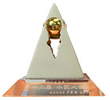
Awards
Innovation Research Award
Only 35 out of 2,800 qualified companies can win the award.
About GoDEX
Rising Star Award
Won Rising Star Award in 2009 from the ministry of economic affairs

Slide 15
GoDEX Services
GoDEX Quality
Services & Supports
Application Fields
Worldwide Offices

Slide 16
GoDEX Quality
100% customer satisfaction focused
DFQ – designed for quality manufacturing
Supplier certification and training
EVT, DVT, MVT, MP development process
SOP assembly line manufacturing
Employee training and certification
Production yield, ORT, and life testing
GoDEX Services

Slide 17
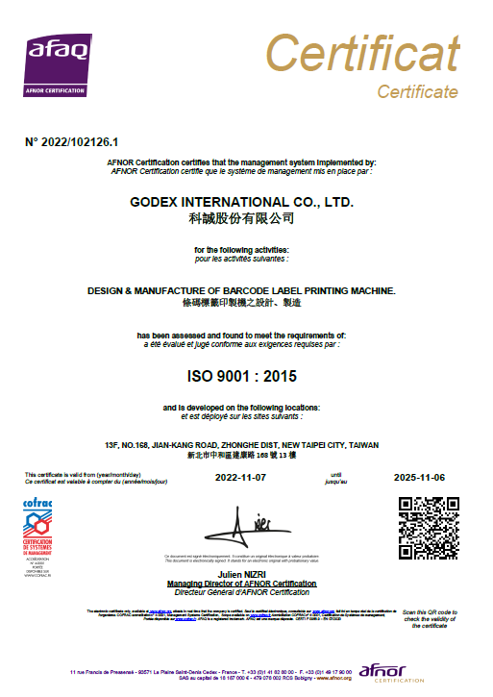
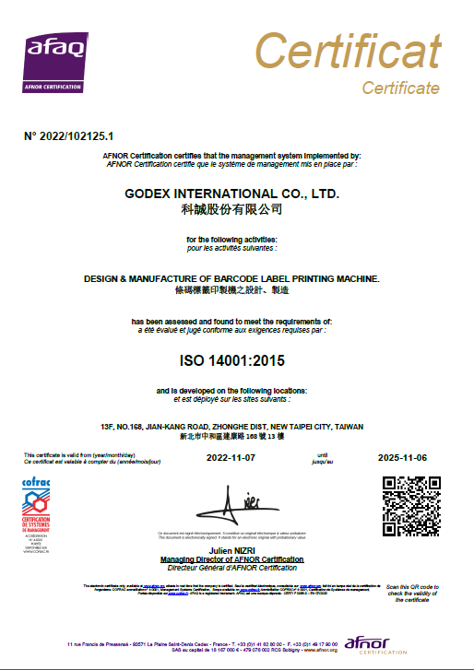
GoDEX Quality
ISO9001 / ISO14001 Certification
GoDEX Services

Slide 18
Services & Supports
Producing high quality products and services is one of the very highest business priorities at GoDEX.
As a hardware technology company, we realize that in order for GoDEX to provide our customers with complete satisfaction, we must provide them with perfect products, supported by exceptional and caring customer service.
GoDEX Services
Service policy
Product Warranty
Product repair
RMA Policy

Slide 19
Application Fields
Entertainment
Healthcare
Inventory Management
Logistics
GoDEX Services
Manufacturing
Retails
Special Materials/ Ticketing
Travel and Leisure
Sports
Transportation

Slide 20
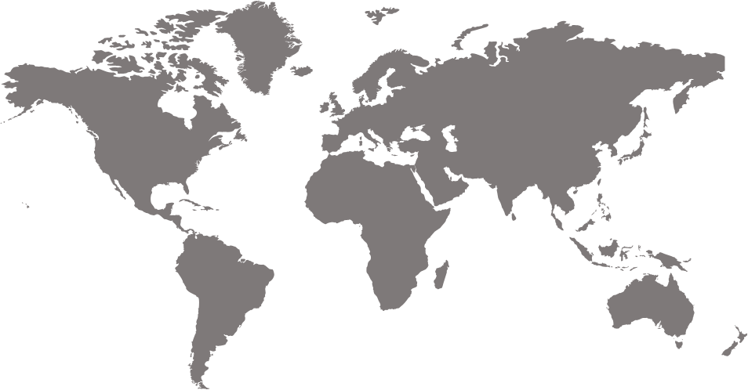
Worldwide Offices
GoDEX Services
Headquarters, Taipei
China, Shanghai
Europe, Germany
Americas, California

Slide 21
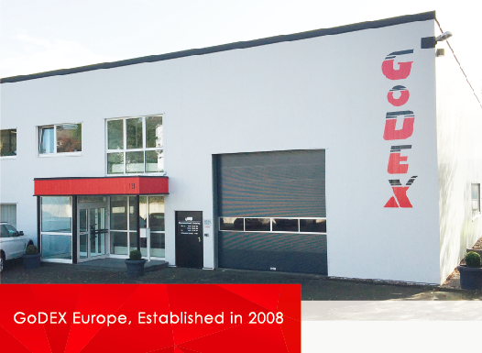
Worldwide Offices
GoDEX Services

Slide 22
Products
Product Line Classification
Customizing Program

Slide 23
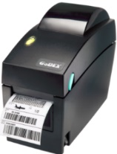
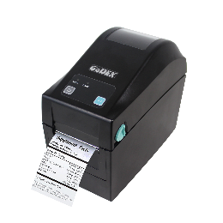
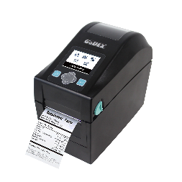
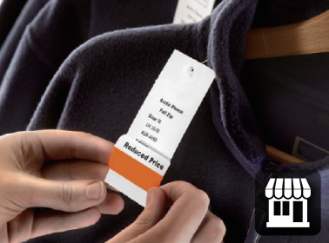
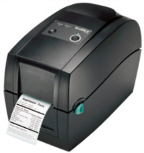
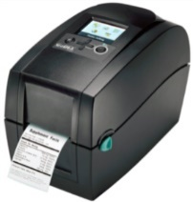
Product Line Classification
Desktop
Print width
2”
DT2x
DT200+ Series
DT200i+ Series
RT200
Series
RT200i
Series

Slide 24
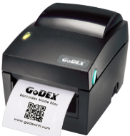
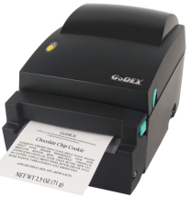
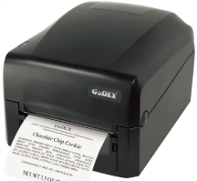
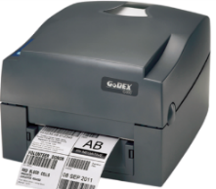
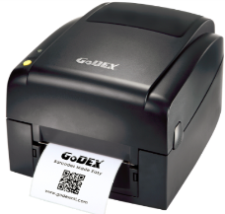
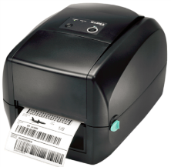
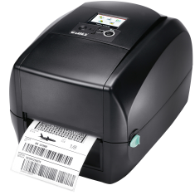
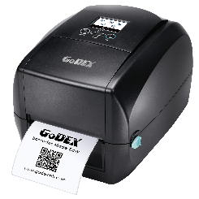
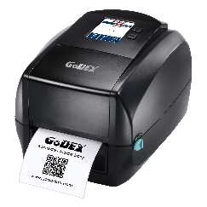
Product Line Classification
Desktop
Print width
4”
DT4x
DT4L
GE300
Series
G500
Series
EZ120
Series
RT700
Series
RT700x
Series
RT700i
Series
RT700i+
Series
RT800i+
Series

Slide 25
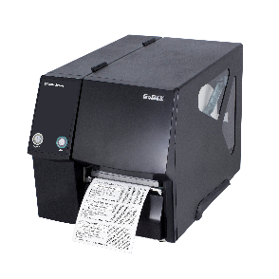
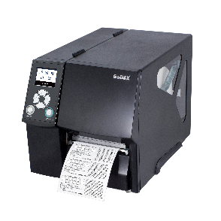
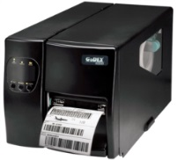
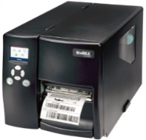
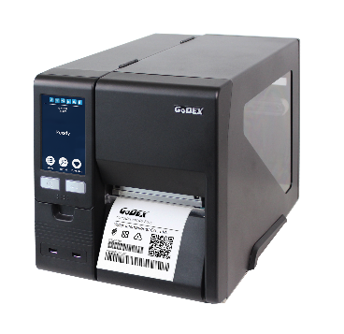
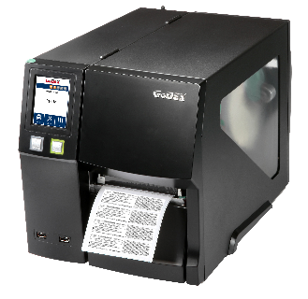
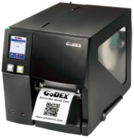
Product Line Classification
Industrial
Print width
4”
ZX400+
Series
ZX400i+
Series
EZ2x50
Series
EZ2x50i
Series
ZX1000i+
Series
ZX1000Xi+
Series
GX4000i
Series

Slide 26
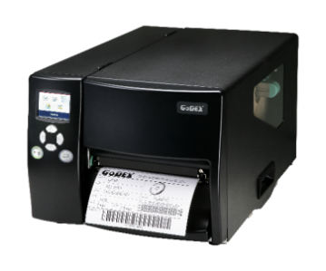
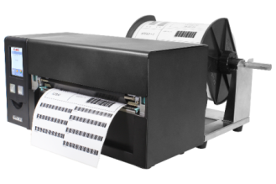
Product Line Classification
Industrial
Print width
6”
EZ6x50i Series
Print width
8”
HD830i+ series

Slide 27
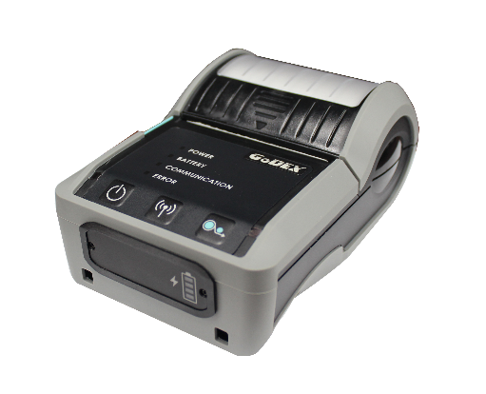
Product Line Classification
Mobile
Print width
3”
MX30+
MX30L+

Slide 28
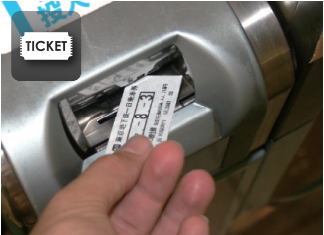
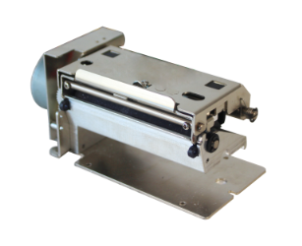
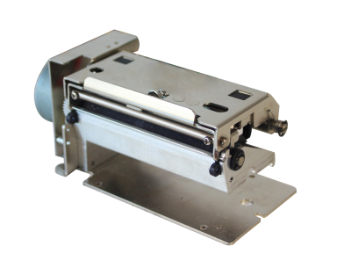
Product Line Classification
Print Mechanism
Print width
2”
PE200 Series
Print width
3”
PE300 Series

Slide 29
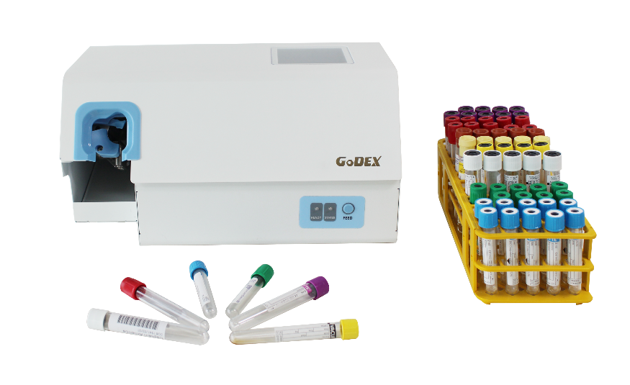
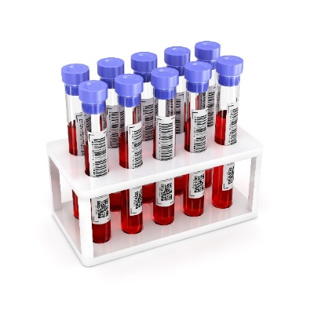
Automated Tube Labeling System
Print width
2”
GTL-100
Product Line Classification

Slide 30
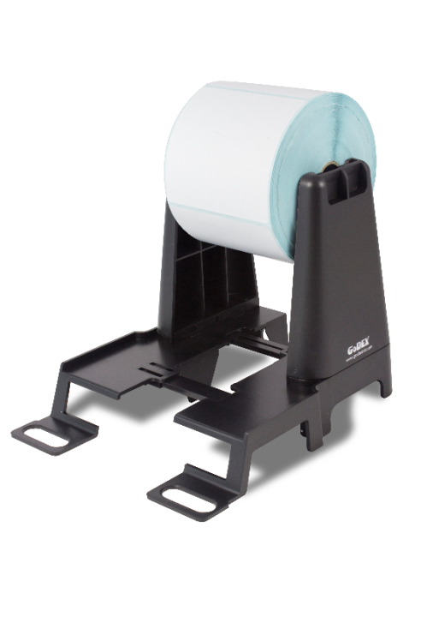
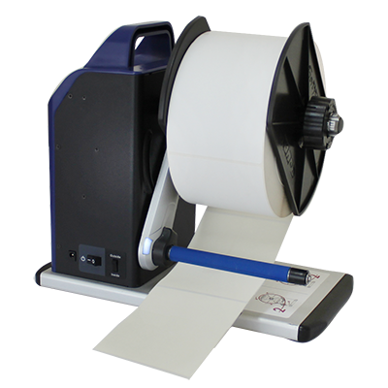
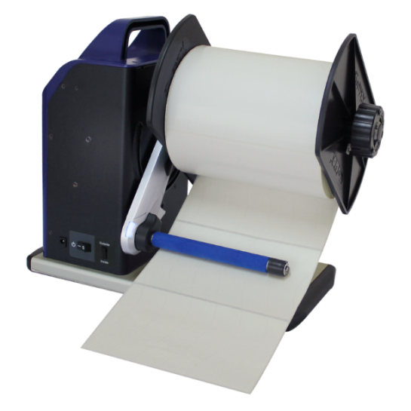
Product Line Classification
Accessories
Label Rewinder
External Label Stand
T-10
(4”)
T-20
(6”)
LH-100

Slide 31
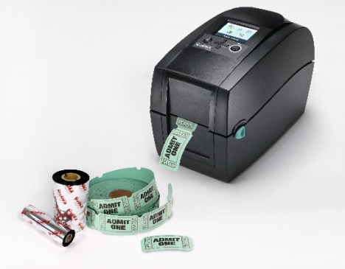
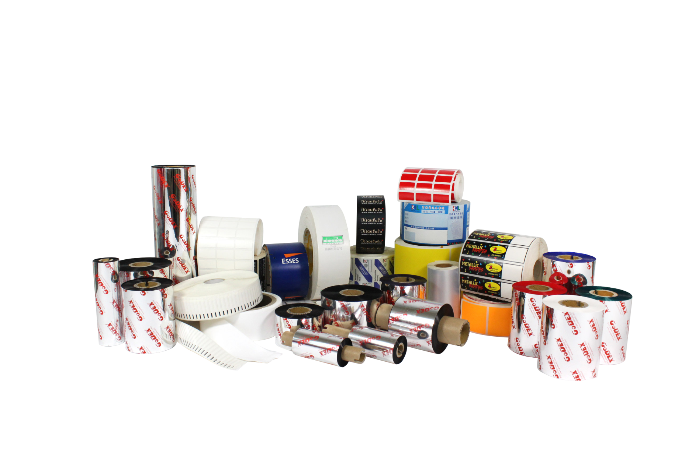
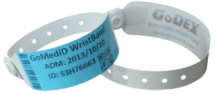
Product Line Classification
Ribbon
High quality GoDEX thermal transfer ribbons.
(Wax/Semi/Resin)

Slide 32
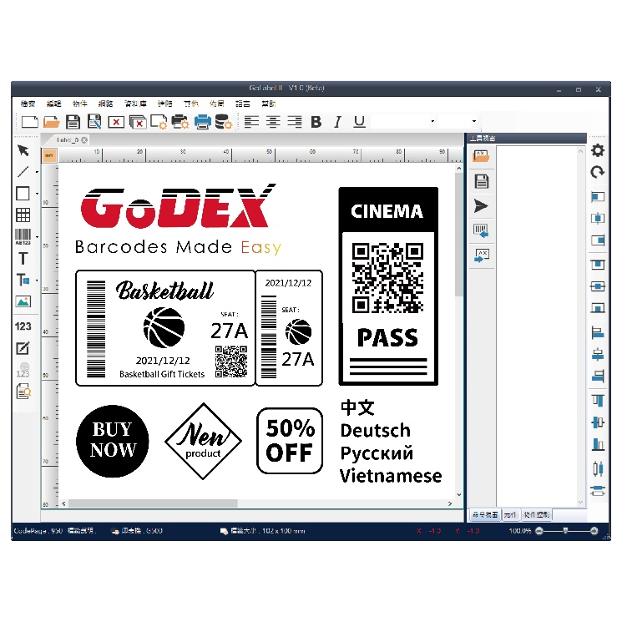
Product Line Classification
Software – GoLabel II (Windows)
LABEL DESIGN SOFTWARE
- User Friendly
- Database support
- What You See is What You Get (WYSIWYG)

Slide 33
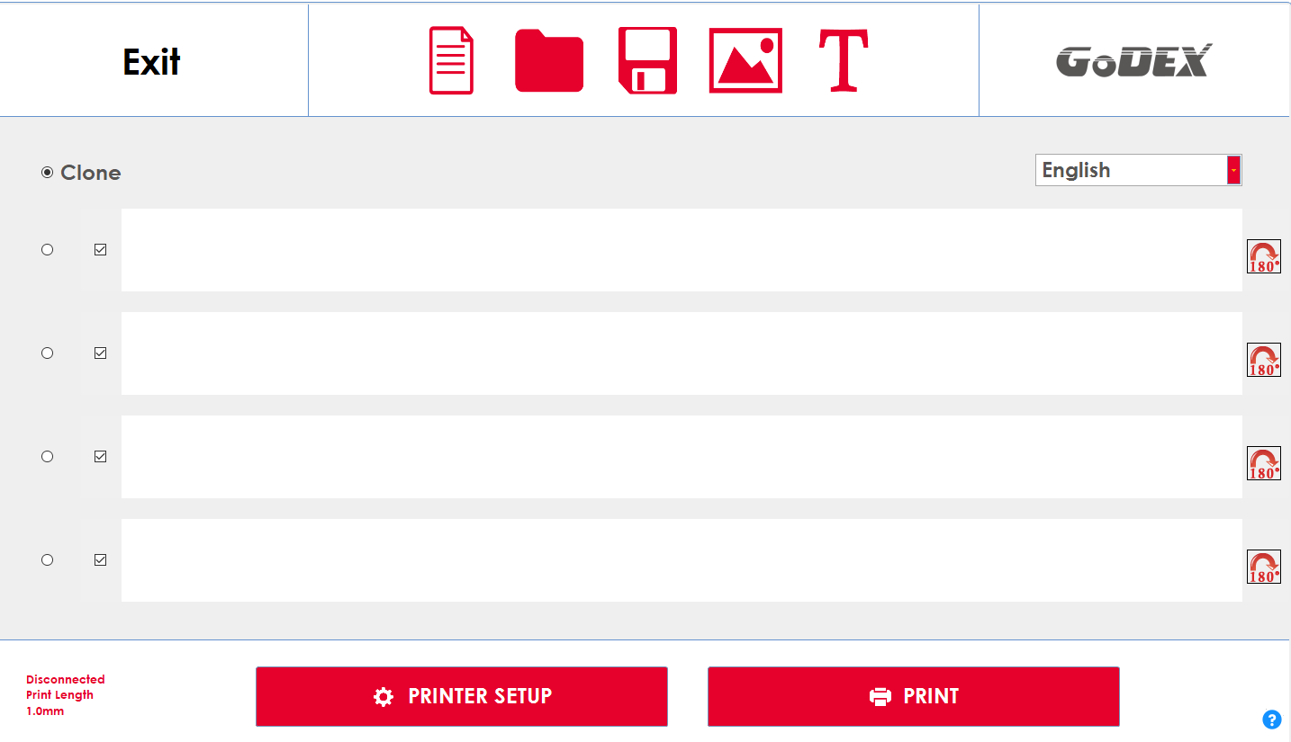
Product Line Classification
Software – GoRibbon (Windows)
Software for Satin Ribbon Printing
It has an intuitive user interface for easy operation. When paired with our custom media guide, GoRibbon supports multiple slots satin ribbon printing to create custom gift ribbons. This software works with all GoDEX printers so you can download and start printing today.

Slide 34
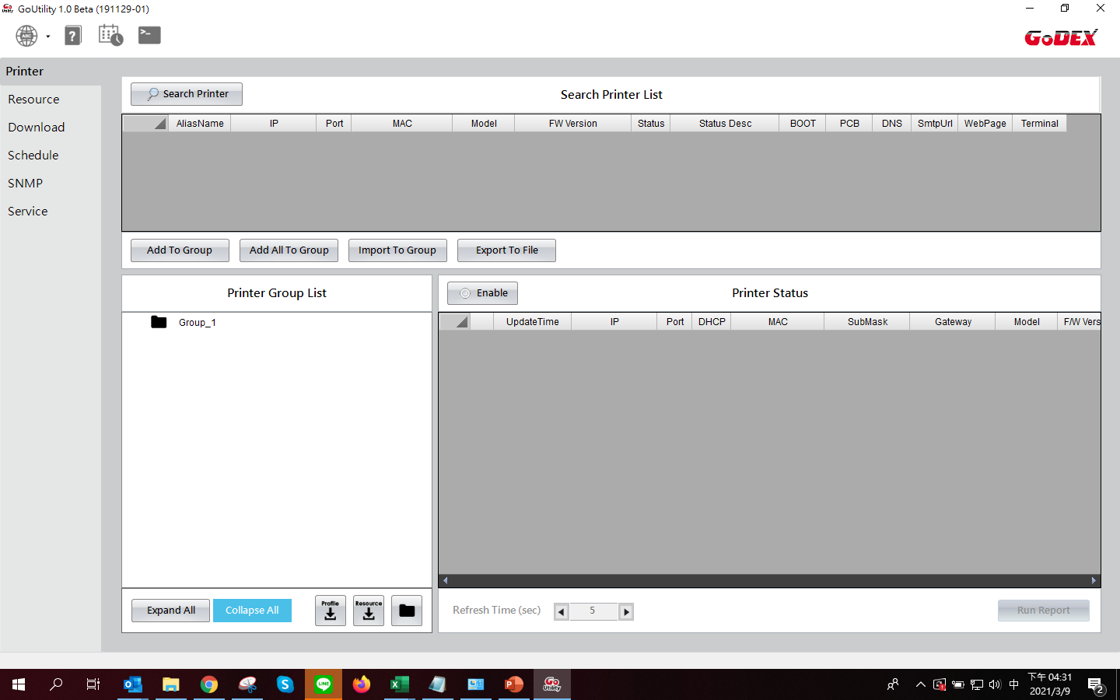
Software – GoUtility (Windows)
Printer Control
Resource Management
File Download
Scheduling Job
SNMP Server
XML Server
Product Line Classification

Slide 35
Software – GoTools (Windows)
Forget about complicated software installing, GoTools will lead to the easiest way
GoTools has contained GoConfig, GoDoctor , Goloader and GoUpdate to assist our network of distributors integrate our printers efficiently.
These 4 Godex tools will not require any commands or programming to configure preference settings; trouble shooting and loading / unloading fonts or label formats and provide superb user experience.
Product Line Classification

Slide 36
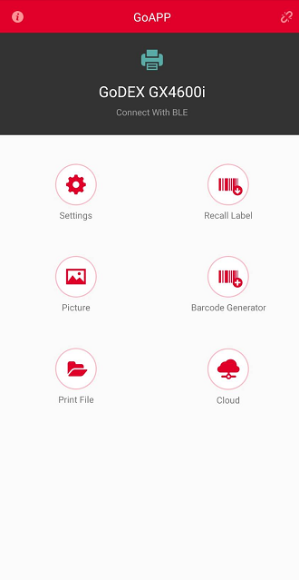
Product Line Classification
App - GoAPP
Available for both iOS and Android system
Easy to operate
Available for Recall Label
Quick for Printer setting
Database supported.

Slide 37
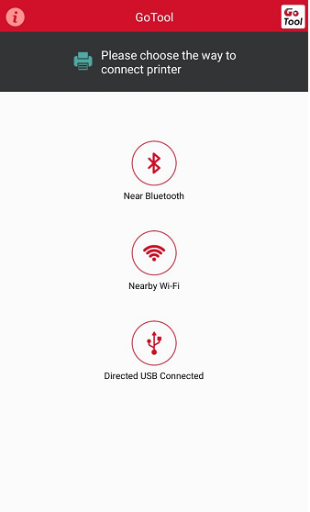
App - GoTools
Available for android
Easy to check printer status
Product Line Classification

Slide 38
Customizing Programs
ODM
OEM
As an Original Design Manufacture, GODEX supplies the customer with a custom product that has been designed by GODEX to meet customer’s specifications.
GODEX manufactures products typically for another manufacturer and under that manufacturers brand name. These products can be complete printers or printer components.
Generic Branding
Customizing
A barcode printer product from GODEX that has no brand on it at all, so that you can brand and personalize this product yourself, in your facility.

Slide 39
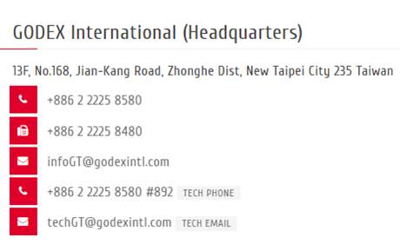
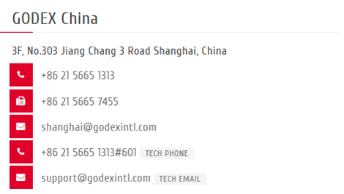
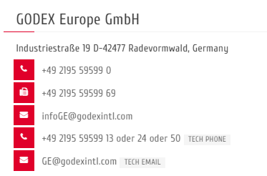
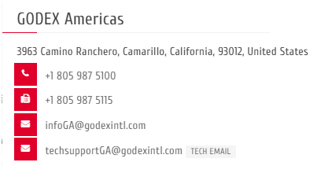
Contact Us
Contacts

Slide 40
Q & A
Questions?

Slide 41
Thank You!
Follow us :
https://www.godexintl.com
Line
Linkin
Facebook

